Slide 1



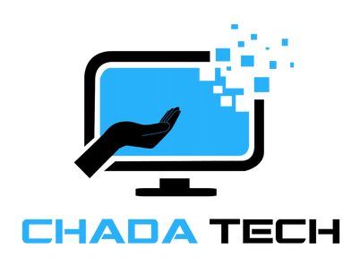

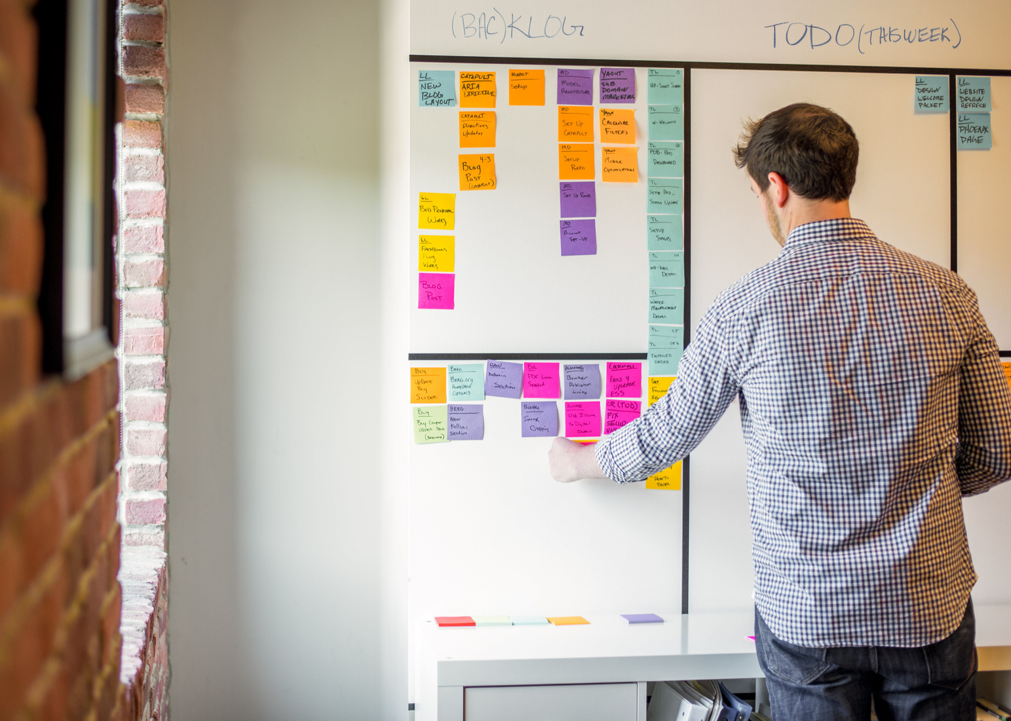

Scrum-Agile
Approach
Susan Lopez
Final Project
CS 250

Slide 2

Scrum-Agile Approach
Agile is an iterative, customer-focused methodology.
Scrum is the most widely used Agile framework.
Key principles:
Deliver value incrementally.
Emphasize collaboration and adaptability.
Ensure continuous feedback and improvement.
Notes:
Agile is a methodology designed to improve flexibility, collaboration, and customer satisfaction.
Scrum, as the most popular Agile framework, is centered around delivering small, usable product increments in short cycles called sprints.
The focus is on continuous improvement and adapting to change.
Today, I’ll guide you through the key facets of Scrum, how it differs from traditional methods like Waterfall, and factors to consider when choosing between these approaches.

Slide 3





Key Roles in Scrum-Agile
Product Owner
Scrum Master
Development Team
Represents the stakeholders and defines product vision. Priotizes the product backlog for mzximum value.
Facilitates Scrum practices and removes raodblocks. Ensures team productivity and adherence to Agile principles.
Cross-functional members deliver product increments. Collaborate daily to achieve sprint goals.

Slide 4

Phases of Scrum Management
Initiation
Planning
Execution
Release
Review
Establish vision and create the initial backlog.
Promote flexibility for evolving project needs.
Sprint planning for short-term achievable goals.
Focus on value-driven prioritization.
Iterative development within sprints.
Continuous collaboration with stakeholders.
Continuous testing ensures quality.
Incremental releases enable feedback-driven adjustments.
Analyze successes and failures to improve future sprints.

Slide 5


Types of Scrum Meeting
Sprint Planning
Daily Scrum
Scrum Review
Backlog Refinement
A meeting at the start of the sprint where the team defines the sprint goal, selects backlog items, and plans the work to be completed.
A 15-minute daily meeting for the team to synchronize progress, plan tasks, and address impediments.
A meeting at the end of the sprint to showcase completed work to stakeholders and gather feedback for future sprints.
An ongoing process to review, prioritize, and clarify backlog items, ensuring they are ready for future sprints.

Slide 6




Waterfall Vs. Agile
Waterfall
Agile
Phases are sequential:
Requirements -> Design -> Development -> Test -> Deploy
Fixed with limited adaptability to changes.
Iterative and incremental delivery.
High adaptability to changing requirements and customer feedback.

Slide 7


Waterfall Vs. Agile
Agile allows to changes to be integrated in the next sprint.
Waterfall may require rework of earlier phases.

Slide 8
When to choose...
Waterfall
Agile
Requirements are fixed and well-defined.
Uncertainty or changing requirements.
Predictable timelines are necessary.
Customer collaboration is critical.
Minimal scope changes are expected.
Incremental delivery is desired.

Slide 9







Benefits of Scrum-Agile
Faster Delivery
Engagement
Quality
Scrum delivers value faster by breaking the work into smaller, manageable increments.
Continuous collaboration ensures the product aligns with customer needs.
Testing throughout the project lifecycle leads to higher-quality outcomes.
Agile reduces risk by allowing teams to adapt to changes.

Slide 10


Resources
Azanha et al. (2017) on Scrum vs. Waterfall.
Rubin (2019) on Scrum practices.
Schwaber & Sutherland (2020) on Scrum Guide.
Wonohardjo et al. (2019) on Scrum roles and success factors.
Hema et al. (2020) on Agile benefits over Waterfall.

Slide 11
Thank You
For Your Attention
Visit Our Website
www.reallygreatsite.com

Slide 12
References in APA
Azanha, A., Argoud, A. R. T., Camargo Junior, J. B., & Antoniolli, P. D. (2017). Agile project management with Scrum. International Journal of Managing Projects in Business, 10(1), 121-142. https://consensus.app/papers/agile-project-management-with-scrum-azanha-argoud/f232466de0bd5963abd273318291fcd4
Wonohardjo, E. P., Sunaryo, R. F., & Sudiyono, Y. (2019). A systematic review of SCRUM in software development. Journal of Informatics and Information Systems, 3(2), 108-112. https://consensus.app/papers/a-systematic-review-of-scrum-in-software-development-wonohardjo-sunaryo/171fec4f52ff501398d5fa6355f166c5
Fowler, F. M. (2018). Scrum and Waterfall. In Navigating Hybrid Scrum Environments. https://consensus.app/papers/scrum-and-waterfall-fowler/e7f4e82bfb655ed1a3b716eac0821330
Halani, K. R., & Jhajharia, K. (2022). A quantitative study of Waterfall and Agile methodologies. Contemporary Challenges for Agile Project Management. https://consensus.app/papers/a-quantitative-study-of-waterfall-and-agile-methodologies-halani-jhajharia/1cc1281b296b5b6abf504933778a8eae
Hema, V., Thota, S., Kumar, S. N., Padmaja, C., & Krishna, C. R. (2020). Scrum: An effective software development agile tool. IOP Conference Series: Materials Science and Engineering, 981(2). https://consensus.app/papers/scrum-an-effective-software-development-agile-tool-hema-thota/f0821802fde45691ad61e46c6d94f064
Rubin, K. S. (2019). Essential Scrum: A Practical Guide to the Most Popular Agile Process. Addison-Wesley.
Schwaber, K., & Sutherland, J. (2020). The Scrum Guide: The Definitive Guide to Scrum: The Rules of the Game. Scrum.org. Retrieved from https://scrumguides.org

